Slide 1
QE and the inflation dogma Does it work and does it make sense?

Slide 2
Agenda
Does the current mandate make sense?
Is monetary policy a suitable tool?
What did QE bring us?
How will QE unwind?
Monetary policy and pensions
Is there another way?

Slide 3
Does the current mandate make sense?

Slide 4
Does the current mandate make sense?
Why does the BoE exist?
To promote the good of the people of the United Kingdom

Slide 5
Does the current mandate make sense?
Mandate is via monetary (price) and financial stability
The remit recognises the role of price stability in achieving economic stability more generally, and in providing the right conditions for sustainable growth in output and employment

Slide 6
Does the current mandate make sense?
Price stability via inflation targeting of
CPI @ 2%
Economic stability
Sustainable growth in spending and investment
Sustainable growth in output and employment

Slide 7
Does the current mandate make sense?
Why a single metric?
Why 2%?

Slide 8
Is a single metric sensible?
Consumer price inflation

Slide 9
Is a single metric sensible?
Necessary but not sufficient
to achieve sustainable economic growth
Consumer price inflation

Slide 10
Is a single metric sensible?
Necessary but not sufficient
to achieve sustainable economic growth
Consumer price inflation
So what else matters?

Slide 11
Is a single metric sensible?
Consumer price inflation
60%

Slide 12
Is a single metric sensible?
Necessary but not sufficient
to achieve sustainable economic growth
Consumer price inflation
So what else matters
for consumers?

Slide 13
Is a single metric sensible?
Wage inflation?
House price inflation?
Consumer price inflation
Rental inflation?
Pension inflation?

Slide 14
Why 2%?
The sweet spot – not too high, not too low
Is 2% relevant now? Is a monetary supply issue?
Ageing population
Technology
Behavioural factors – why it’s still 2%
Status quo bias, experts’ opinion, fear of regret, anchoring

Slide 15
Is monetary policy a suitable tool?

Slide 16
The central banker’s toolbox
Setting base rates
Macro-prudential regulation
Open market operations
Quantitative Easing (QE)

Slide 17
The central banker’s toolbox
Different tools, same intention
Monetary policy is about
the yield curve i.e. the cost of credit
the relative value of risk-free and risky assets
Lower rates to …..
increase aggregate demand through credit expansion
push capital into riskier assets

Slide 18
The central banker’s toolbox
Set the base rate
Longer terms affected through expectation

Slide 19
The central banker’s toolbox
Set the base rate
Longer terms affected through expectation
Add QE for direct influence

Slide 20
Is monetary policy a suitable tool to lower inflation?
Yes
Effective since 1992
Basis for current mandate
Can raise rates to arbitrary level

Slide 21
UK CPI 1989 - 2017
UK exits ERM
Inflation targeting introduced

Slide 22
Is monetary policy a suitable tool to raise inflation?
A blunt tool
With costs
And limitations

Slide 23
Limitations of monetary policy
No guarantee cheaper credit is used
No guarantee it’s used for intended purpose
The lower bound and diminishing returns
Postpones the issue, doesn’t fix it

Slide 24
A 30-year decline in interest rates

Slide 25
What are the alternatives to monetary policy?

Slide 26
What are the alternatives to monetary policy?
Fiscal policy – tax, investment, spending
Stimulates economy directly
Not credit-driven -> upfront cost -> politically unpopular

Slide 27
What did QE bring us?

Slide 28
Background – March 2009
…the MPC judged at its March meeting that a further monetary loosening was required. In particular, it was concerned that nominal spending in the economy would otherwise be too weak to meet the inflation target in the medium term

Slide 29
Background – March 2009
The aim of quantitative easing is to inject money into the economy in order to revive nominal spending
It should ultimately lead to an increase in asset prices and spending and therefore bring inflation back to target

Slide 30
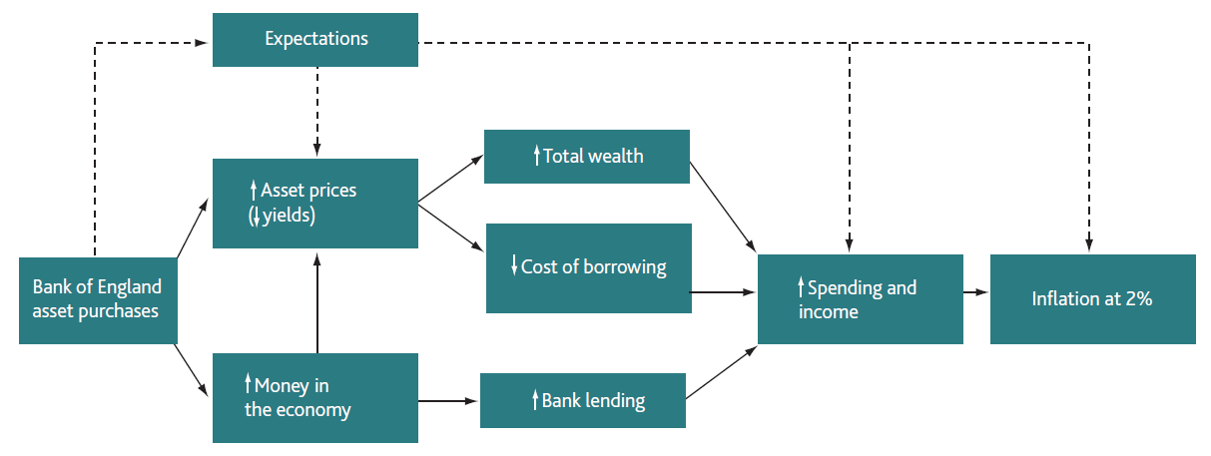
Mechanism

Slide 31
Mechanism
Asset purchases could have an important impact on expectations

Slide 32
Mechanism
…higher asset prices increase the wealth of asset holders, which should boost their spending

Slide 33
Mechanism
More bank lending to households and companies should help to support higher consumption and investment

Slide 34
What does QE look like?
What’s happening to….
The gilt curve
The amount of bonds purchased
Asset prices
GDP
Inflation

Slide 35
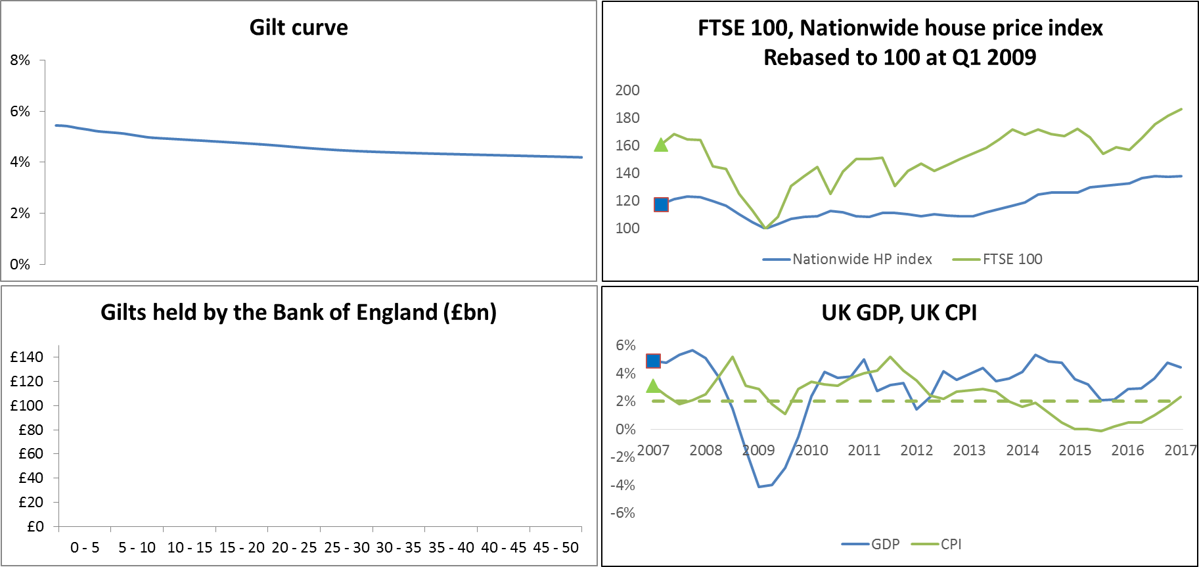
Q1 2007

Slide 36
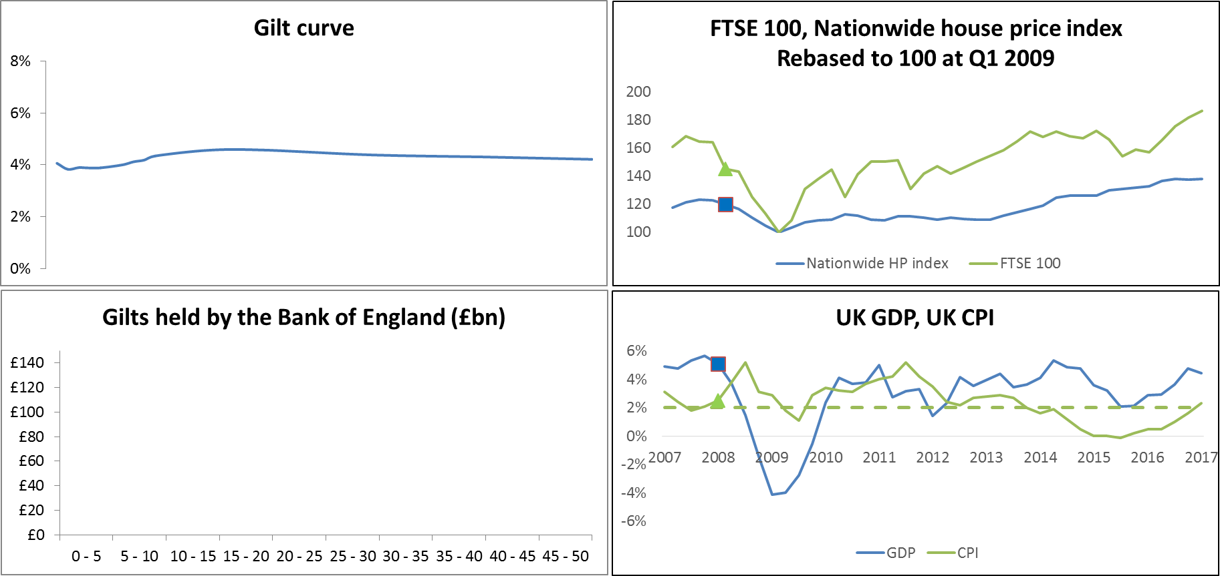
Q1 2008

Slide 37
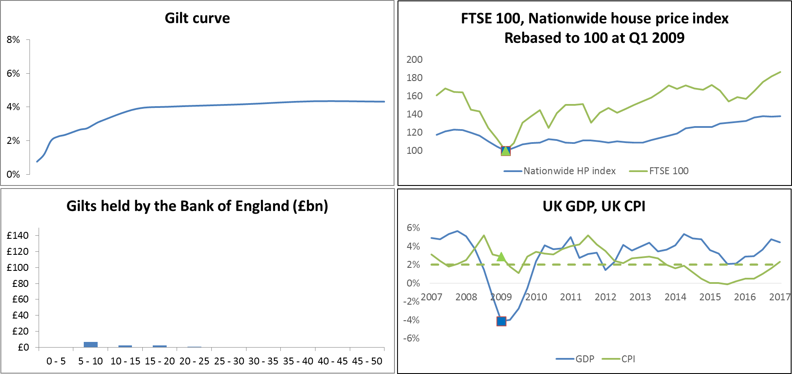
Q1 2009

Slide 38
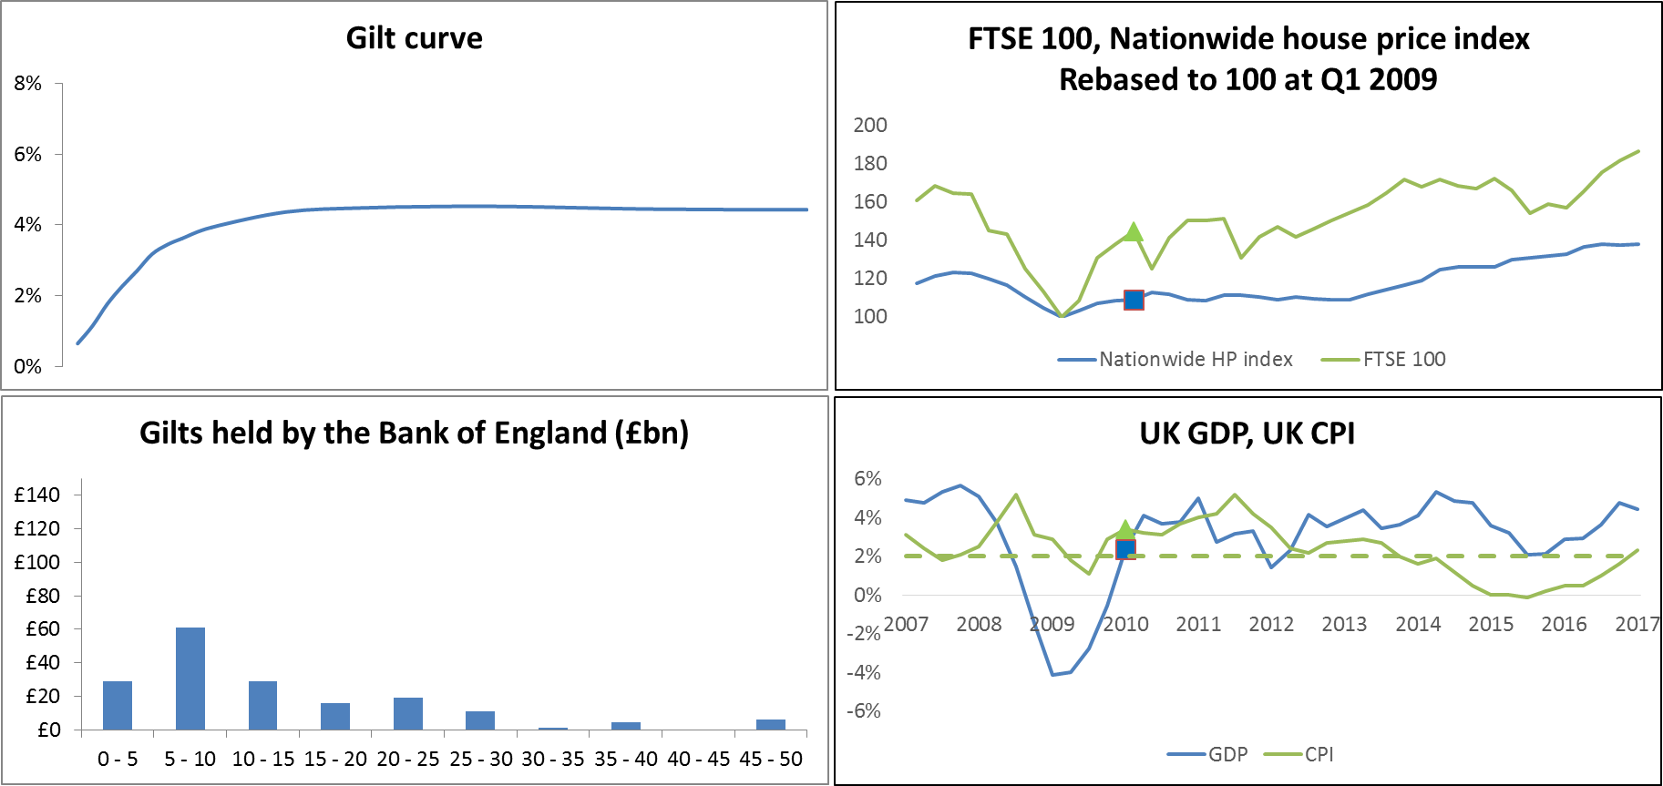
Q1 2010

Slide 39
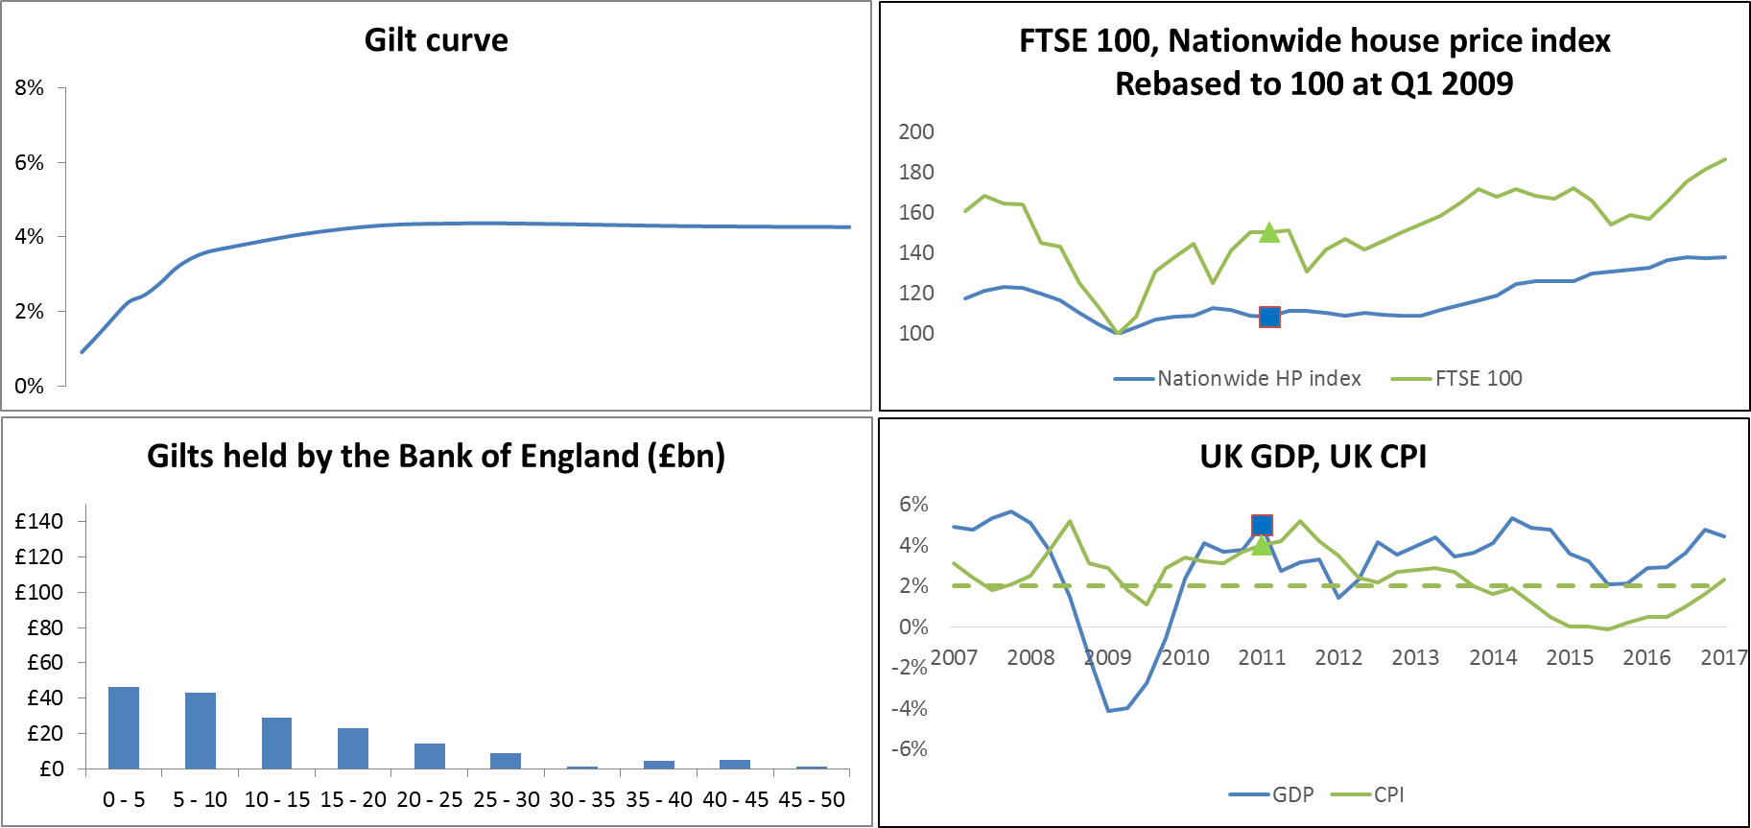
Q1 2011

Slide 40
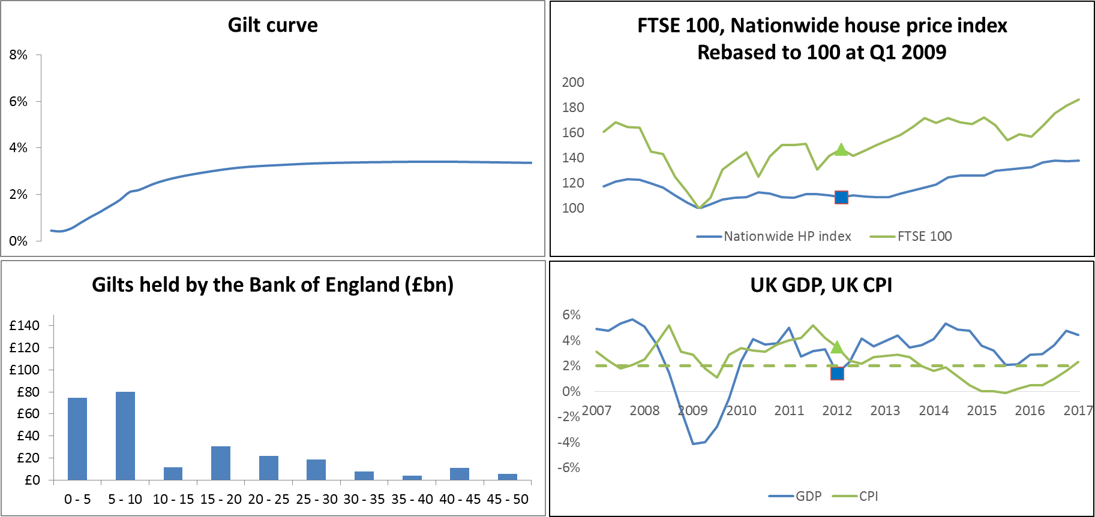
Q1 2012

Slide 41
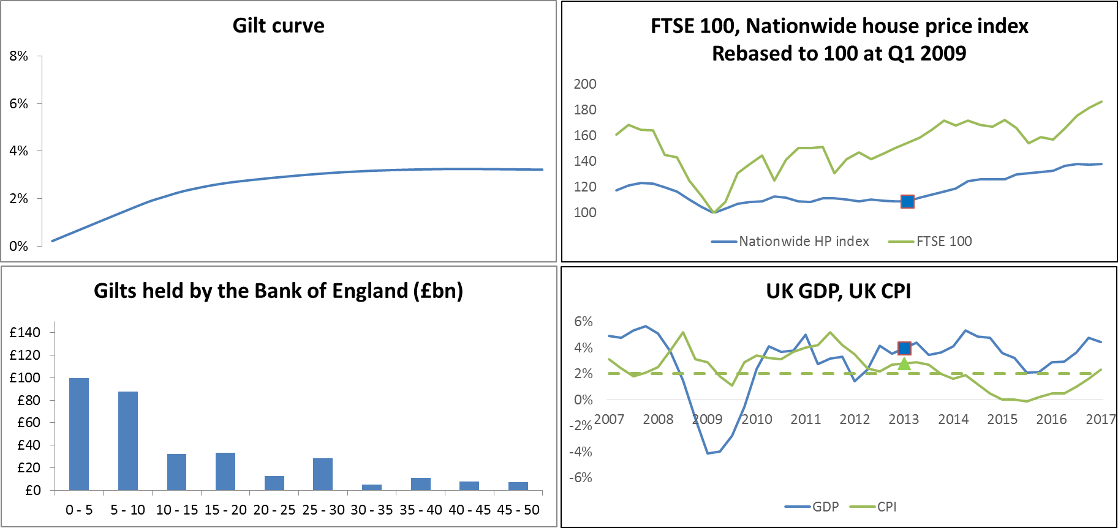
Q1 2013

Slide 42
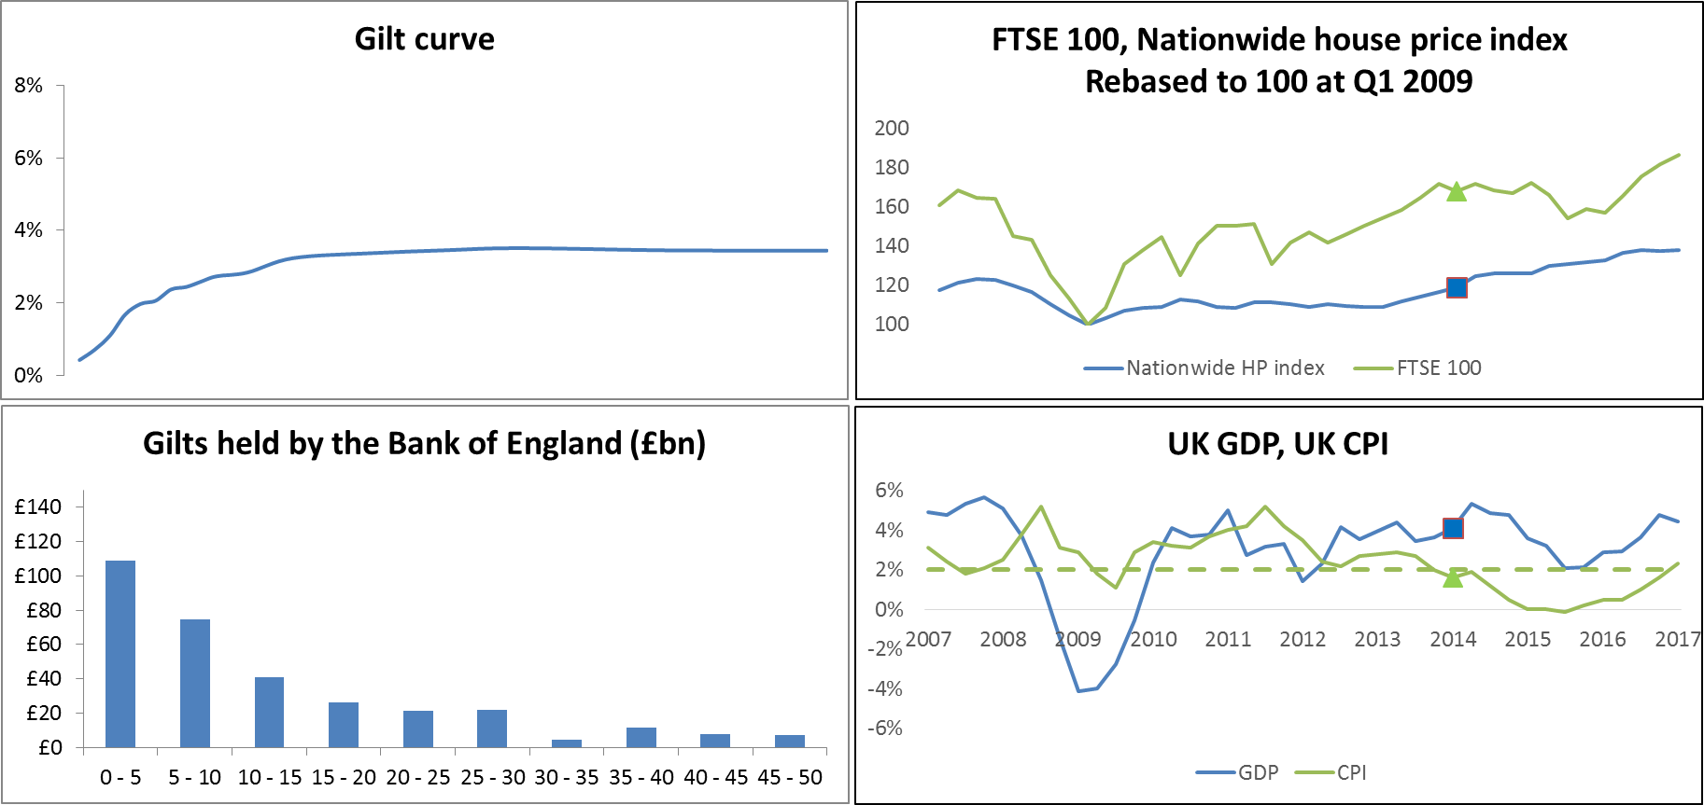
Q1 2014

Slide 43
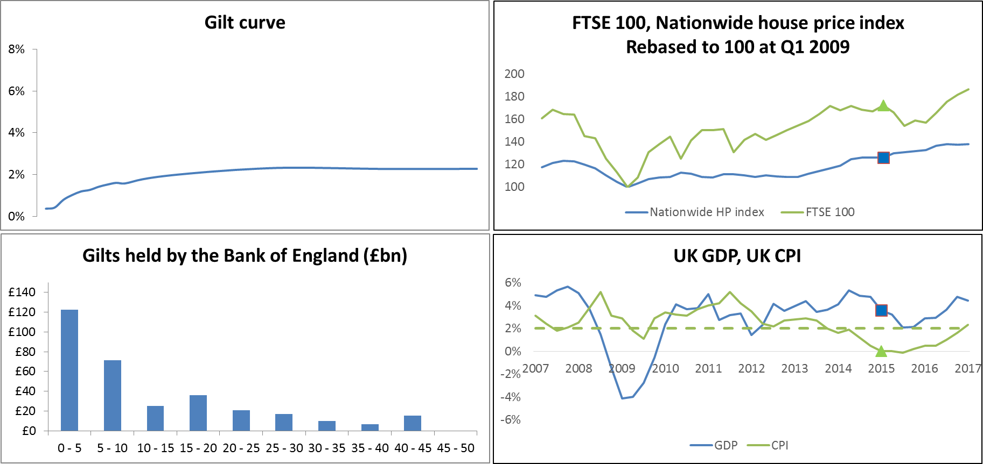
Q1 2015

Slide 44
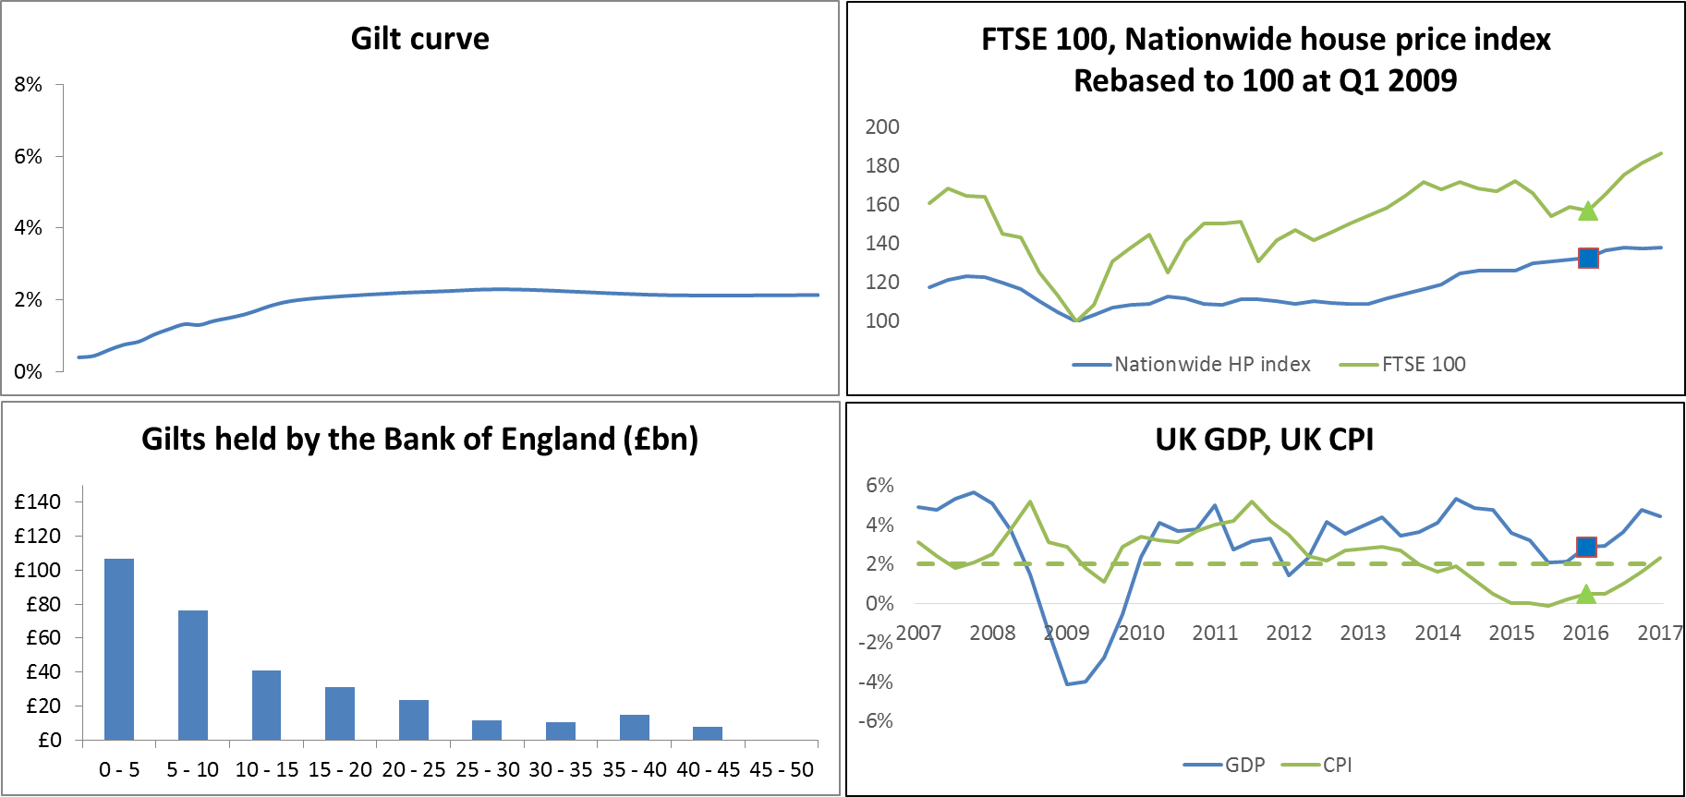
Q1 2016

Slide 45
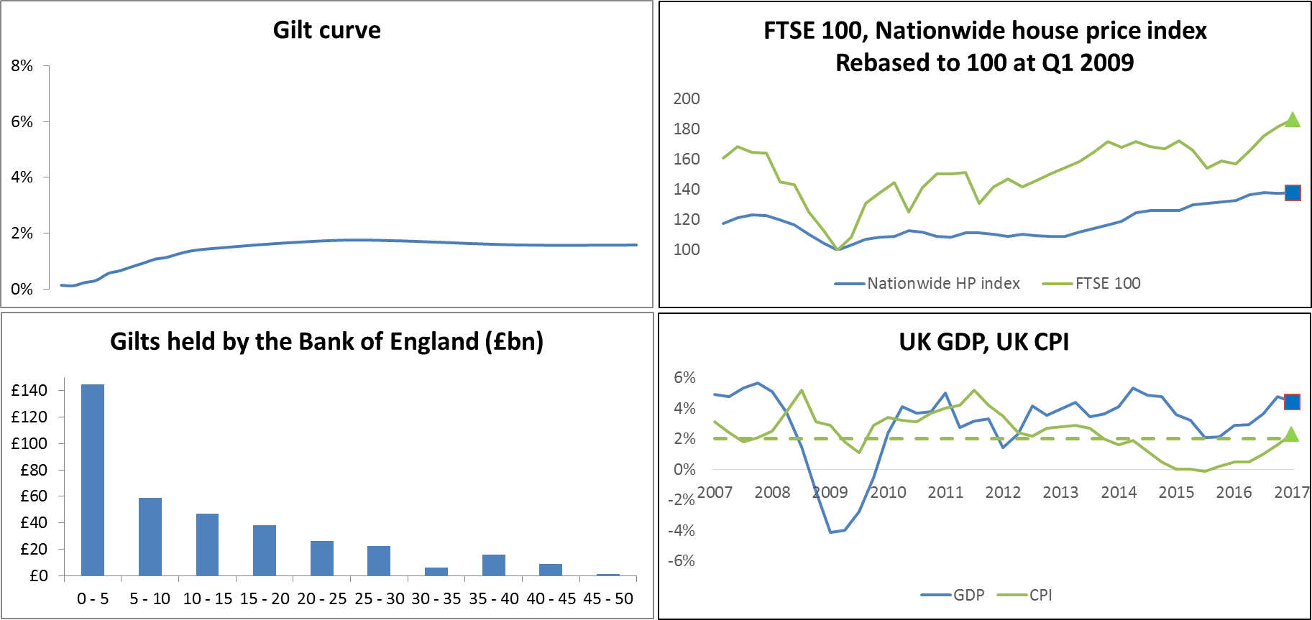
Q1 2017

Slide 46
Q1 2009 – Q1 2017
30-year spot rate | 4.2% -> 1.7%
FTSE 100 | + 87%
Nationwide Housing Index | + 38%
Real GDP | 3.5%
Average CPI | 2.2%

Slide 47
Q1 2007

Slide 48
Q1 2008

Slide 49
Q1 2009

Slide 50
Q1 2010

Slide 51
Q1 2011

Slide 52
Q1 2012

Slide 53
Q1 2013

Slide 54
Q1 2014

Slide 55
Q1 2015

Slide 56
Q1 2016

Slide 57
Q1 2017

Slide 58
QE did what it promised
It should ultimately lead to an increase in asset prices and spending and therefore bring inflation back to target

Slide 59
QE did what it promised
It should ultimately lead to an increase in asset prices and spending and therefore bring inflation back to target
But what else did it bring us?

Slide 60
What else did QE bring us?
Debt

Slide 61
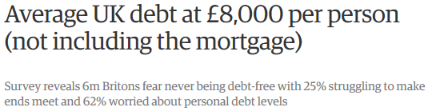
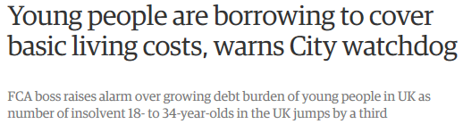
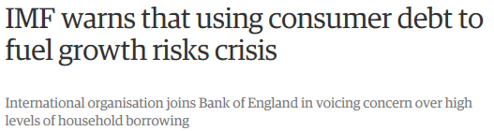
What else did QE bring us?

Slide 62
What else did QE bring us?
Debt
Dependency

Slide 63
What else did QE bring us?
Debt
Dependency
Market distortion

Slide 64
The (extreme) search for yield
In 2016 Austria sold 2bn Euros of 70-year debt at 1.5%
Consider the risks:
Long term, very high duration
Will the Euro exist in 70 years’ time?
For context, for SII, EIOPA deem the last liquid point for the Euro to be 20 years

Slide 65
The (extreme) search for yield
In 2016 Austria sold 2bn Euros of 70-year debt at 1.5%
In 2017 Austria sold 3.5bn Euros of 100-year debt at 2.1%
Consider the risks:
Long term, very high duration
Will the Euro exist in 70 years’ time?
For context, for SII, EIOPA deem the last liquid point for the Euro to be 20 years

Slide 66
Yet the market is (implied) calm
Similar confidence, outlook, sentiment now vs. 2005?

Slide 67
What else did QE bring us?
Debt
Dependency
Market distortion
Pension deficits

Slide 68
What else did QE bring us?
Debt
Dependency
Market distortion
Pension deficits
A new predicament

Slide 69
What else did QE bring us?
Debt
Dependency
Market distortion
Pension deficits
A new predicament
Central bank cannot walk away
Nor can it stay there forever
How does it extract itself?

Slide 70
How will QE unwind?

Slide 71
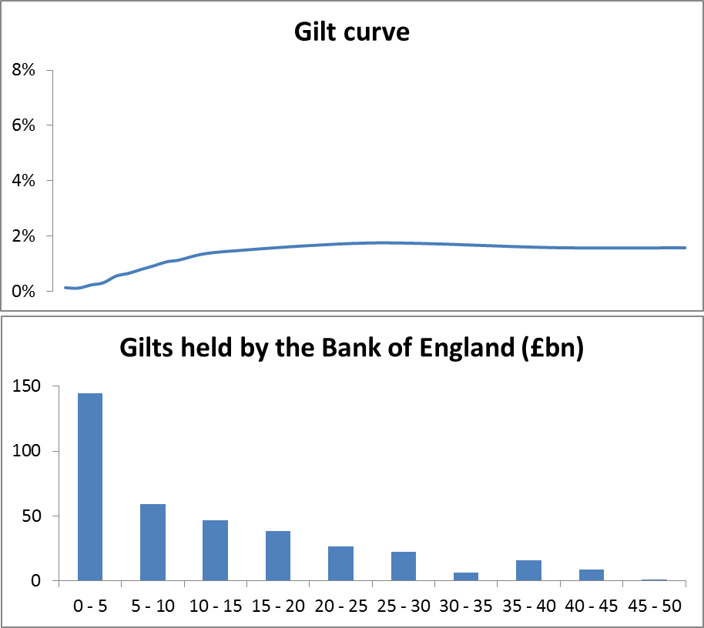
Q1 2017

Slide 72
The options
Sell bonds, reduce balance sheet
Let bonds mature, with no repurchase
Repurchase such that maturity and/or notional reduce over time
Rollover indefinitely i.e. no unwind

Slide 73
The options
Sell bonds, reduce balance sheet
Let bonds mature, with no repurchase
Repurchase such that maturity and/or notional reduce over time
Rollover indefinitely i.e. no unwind
+……when should rates rise?

Slide 74
Balance of gilts if QE left to run off (£bn)

Slide 75
What the Bank of England has said
Q1 2009
The MPC will decide on the most appropriate way to withdraw the policy stimulus based on the circumstances prevailing at the time

Slide 76
What the Bank of England has said
Q1 2014
We’re not going to sell £375 billion of gilts.
That’s a hypothetical question, purely hypothetical
Mark Carney to the Treasury Select Committee

Slide 77
What the Bank of England has said
Q2 2014
The MPC’s preference is to use Bank Rate as the active marginal instrument for monetary policy

Slide 78
What the Bank of England has said
Q4 2015
The MPC expects to maintain the stock of purchased assets at £375 billion until Bank Rate has reached a level from which it can be cut materially

Slide 79
What the Bank of England has done
Q3 2017
Base rate 0.25% ->0.50%
The Committee also voted unanimously to maintain the stock of UK government bond purchase

Slide 80
Monetary policy and pensions

Slide 81

What does the Bank of England think about pensions?

Slide 82
What does the Bank of England think about pensions?
Andy Halldane
Bank of England chief economist
Next governor?

Slide 83
What does the Bank of England think about pensions?
May 2016
I confess to not being able to make the remotest sense of pensions

Slide 84
What does the Bank of England think about pensions?
August 2016, on the best option for retirement
It ought to be pensions but it’s almost certainly property

Slide 85
What does the Bank of England think about pensions?
Assets matter…..
Liabilities don’t?

Slide 86
What does the Bank of England think about pensions?
Publication | Word count on asset | Word count on liability
Quantitative easing Quarterly Bulletin Q2 2009
The United Kingdom’s quantitative easing policy: design, operation and impact Quarterly Bulletin Q3 2011

Slide 87
What does the Bank of England think about pensions?
Publication | Word count on asset | Word count on liability
Quantitative easing Quarterly Bulletin Q2 2009 | 173
The United Kingdom’s quantitative easing policy: design, operation and impact Quarterly Bulletin Q3 2011 | 163

Slide 88
What does the Bank of England think about pensions?
Publication | Word count on asset | Word count on liability
Quantitative easing Quarterly Bulletin Q2 2009 | 173 | 0
The United Kingdom’s quantitative easing policy: design, operation and impact Quarterly Bulletin Q3 2011 | 163 | 0

Slide 89
What does the Bank of England think about pensions?
Essentially ignored
Not part of the mandate

Slide 90
The impact of QE on pensions

Slide 91
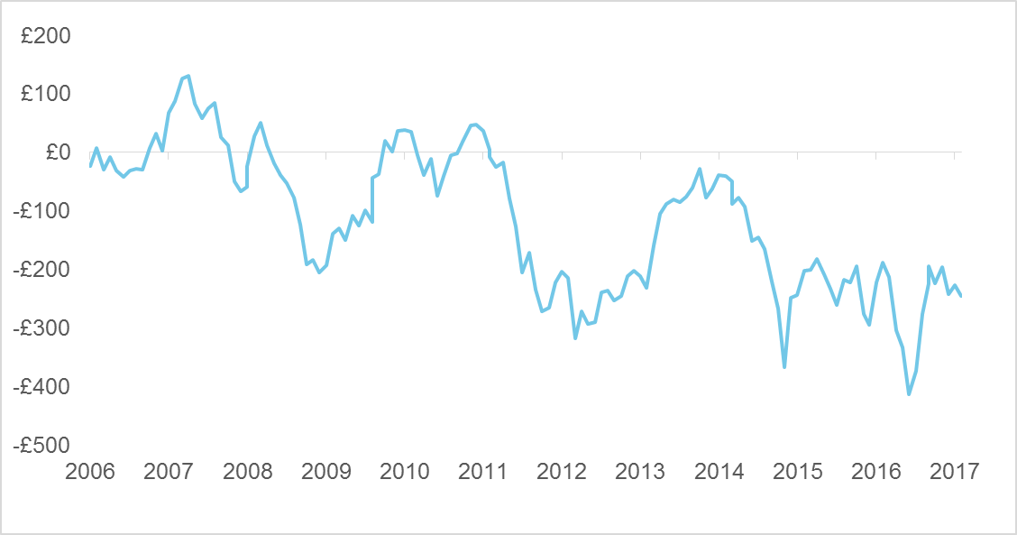
The impact of QE on pensions
PPF estimate of aggregate DB deficits (£bn)

Slide 92
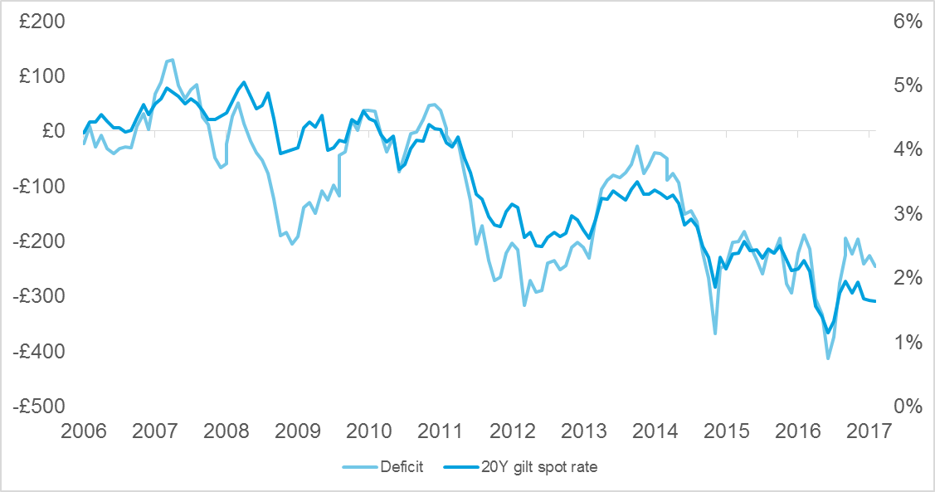
The impact of QE on pensions
PPF estimate of aggregate DB deficits (£bn)
+ 20Y gilt spot rate

Slide 93
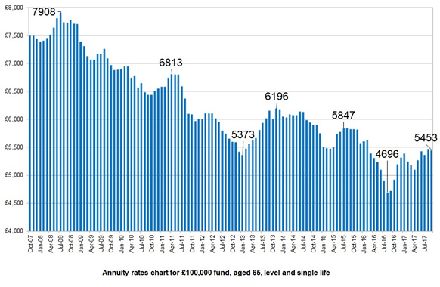
The impact of QE on pensions
Falling annuity rates
Source: sharingpensions.co.uk

Slide 94
The impact of QE on pensions
How sustainable and secure are DB schemes?
Subject of recent government consultation

Slide 95
The impact of QE on pensions
How sustainable and secure are DB schemes?
Subject of recent government consultation
Broadly affordable
Some schemes may struggle

Slide 96
The impact of QE on pensions
How sustainable and secure are DB schemes?
Subject of recent government consultation
Broadly affordable
Some schemes may struggle
Affordable but at what cost?

Slide 97
The impact of pension costs on Bank of England’s aims
An implicit assumption that it doesn’t impact Bank’s primary aims
To promote the good of the people of the United Kingdom
(via) sustainable growth in output and employment

Slide 98
The impact of pension costs on Bank of England’s aims
Inflation ratchet in DB schemes
The end of secure retirement?
Diverting business investment and wage growth

Slide 99
Is there another way?

Slide 100
Is there another way?
Question | Answer
Does the current mandate make sense?
Is monetary policy a suitable tool?
What did QE bring us?
How will QE unwind?

Slide 101
Is there another way?
Question | Answer
Does the current mandate make sense? | No – CPI tells you little in isolation And 2% is increasingly arbitrary
Is monetary policy a suitable tool?
What did QE bring us?
How will QE unwind?

Slide 102
Is there another way?
Question | Answer
Does the current mandate make sense? | No – CPI tells you little in isolation And 2% is increasingly arbitrary
Is monetary policy a suitable tool? | To lower inflation, yes To raise inflation, it’s a blunt tool
What did QE bring us?
How will QE unwind?

Slide 103
Is there another way?
Question | Answer
Does the current mandate make sense? | No – CPI tells you little in isolation And 2% is increasingly arbitrary
Is monetary policy a suitable tool? | To lower inflation, yes To raise inflation, it’s a blunt tool
What did QE bring us? | Exactly what it promised. And more… Debt, dependency, distortion, new risks
How will QE unwind?

Slide 104
Is there another way?
Question | Answer
Does the current mandate make sense? | No – CPI tells you little in isolation And 2% is increasingly arbitrary
Is monetary policy a suitable tool? | To lower inflation, yes To raise inflation, it’s a blunt tool
What did QE bring us? | Exactly what it promised. And more… Debt, dependency, distortion, new risks
How will QE unwind? | Rates then QE (maybe)

Slide 105
The issues that central banks need to address
Short-termism

Slide 106
The issues that central banks need to address
Short-termism
Narrow view

Slide 107
The issues that central banks need to address
Short-termism
Narrow view
Denial that monetary policy has limitations and costs

Slide 108
The issues that central banks need to address
Short-termism
Narrow view
Denial that monetary policy has limitations and costs
Application of outdated economics

Slide 109
What needs to be change?
Genuine oversight and accountability

Slide 110
What needs to be change?
Genuine oversight and accountability
Better alignment of fiscal and monetary policy

Slide 111
What needs to be change?
Genuine oversight and accountability
Better alignment of fiscal and monetary policy
Wider mandate

Slide 112
What needs to be change?
Genuine oversight and accountability
Better alignment of fiscal and monetary policy
Wider mandate
Start to unwind QE – intention is key

Slide 113
Long term thinking is vital
Colin Wilson

Slide 114
Questions
Comments
The views expressed in this [publication/presentation] are those of invited contributors and not necessarily those of the IFoA. The IFoA do not endorse any of the views stated, nor any claims or representations made in this [publication/presentation] and accept no responsibility or liability to any person for loss or damage suffered as a consequence of their placing reliance upon any view, claim or representation made in this [publication/presentation].
The information and expressions of opinion contained in this publication are not intended to be a comprehensive study, nor to provide actuarial advice or advice of any nature and should not be treated as a substitute for specific advice concerning individual situations. On no account may any part of this [publication/presentation] be reproduced without the written permission of the IFoA [or authors, in the case of non-IFoA research].

